Slide 1
How to change between components
!!!

Slide 2
Review Current Change Component Flows in model
Go to new component
startComponent
UpdateHistoryStacks
Back to previous component (normal cases)
CleanHistoryStacks
resumeLastComponent

Slide 3
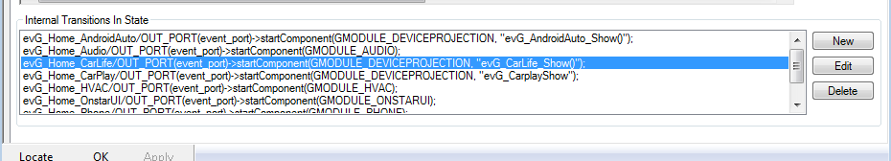
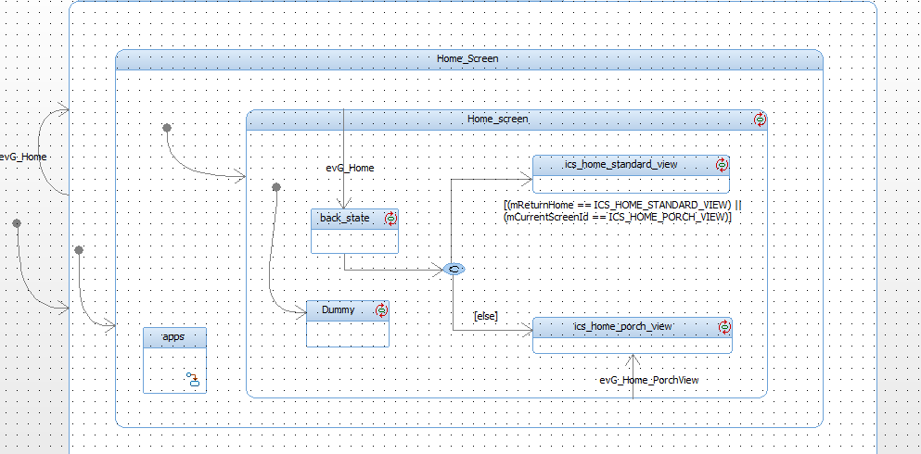
Go to new component (Indirectly)
Change component through internal transition with startComponent() in HOME statechart

Slide 4
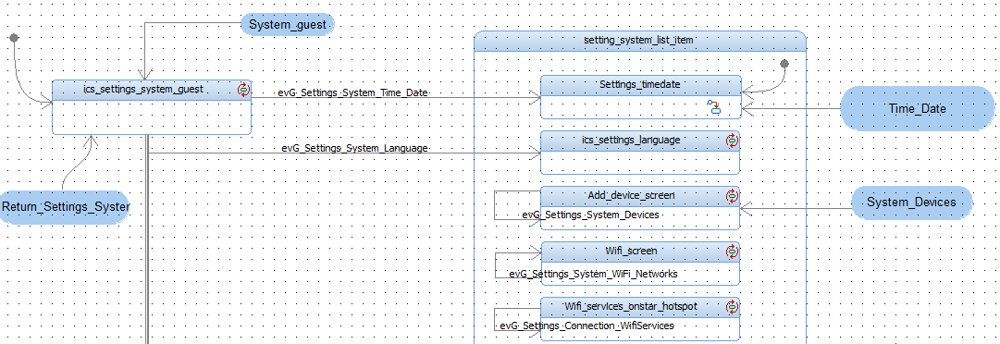
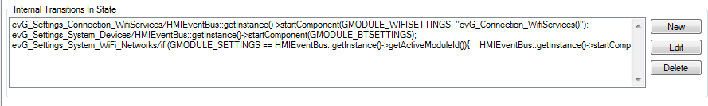
Go to new component (Indirectly)
Change component through startComponent() in substates in current statechart

Slide 5
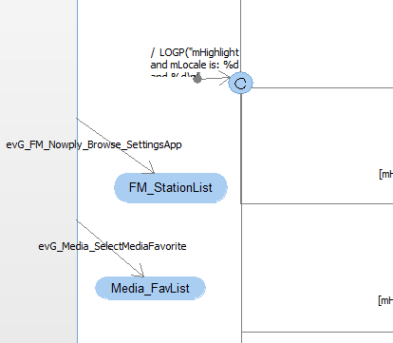
Go to new component (Directly) – 3rd way
Send event directly to next component

Slide 6
Back to previous component
Back using code
Using StateStack to store LastState of components each time we change components.
Take theses LastState to enter each time we back.

Slide 7
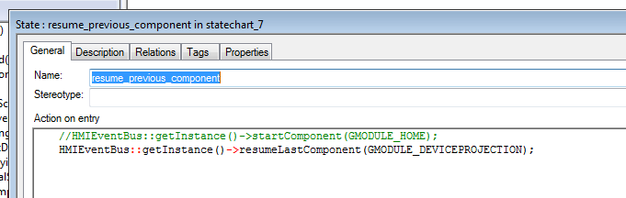
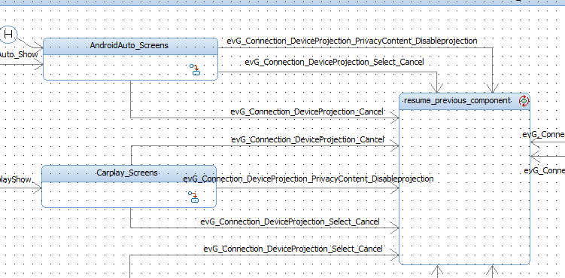
Back to previous component
Using resumeLastComponent in a state

Slide 8
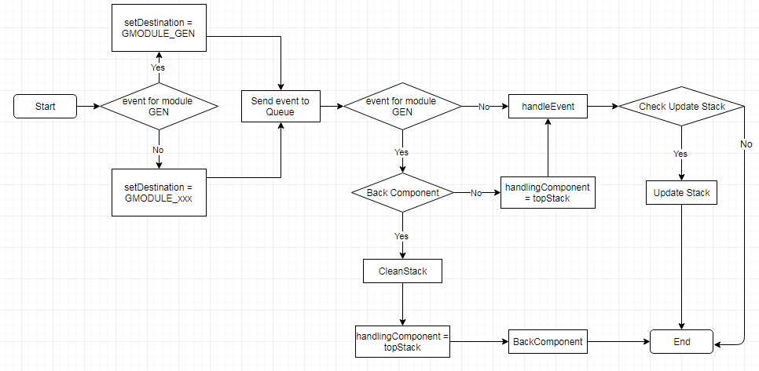
Common EventHandle Flow
Execute loop of EventThread

Slide 9
Remain issue:
Back with condition

